Slide 1
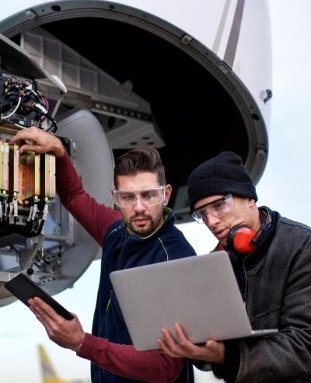
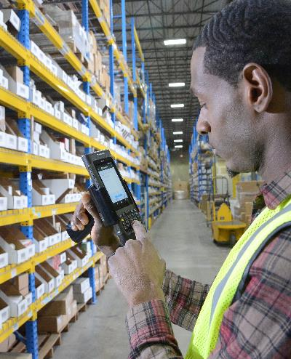



Sensing and timing at Honeywell
Neal SOlmeyer
  Staff scientist, advanced sensors and microsystems Plymouth, MN
  Robert Compton, josh dorr, chad Fertig, Chad hoyt, sally-ann keyes, neil krugger, karl nelson, matthew puckett
This research was developed with funding from the Defense Advanced Research Projects Agency (DARPA)
The views, opinions and/or findings expressed are those of the author and should not be interpreted as representing the official views or policies of the Department of Defense or the U.S. Government.

Slide 2
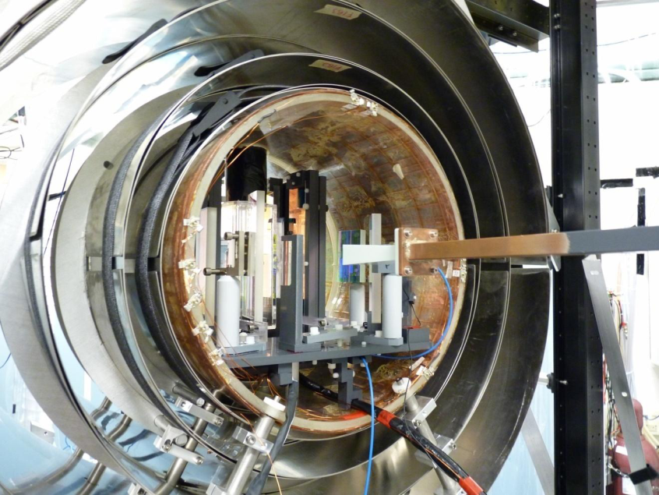
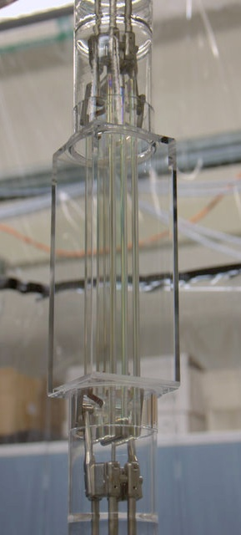

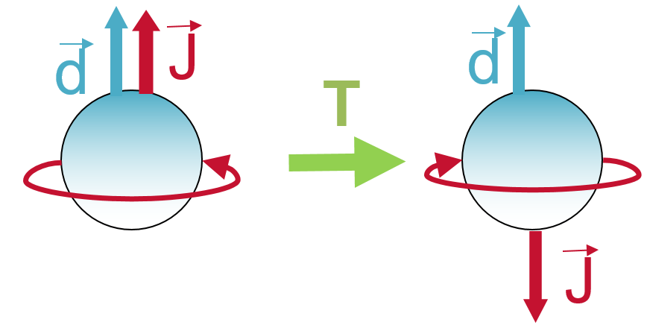

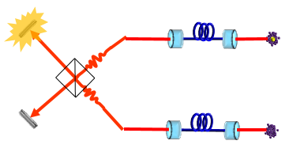
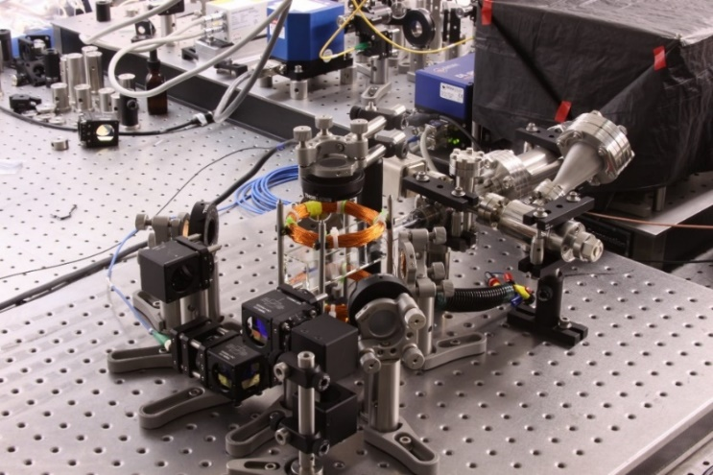
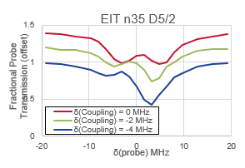

PhD. Penn State 2013 : Measurement of electric dipole moment of the electron
Army Research Laboratory, Adelphi MD, 2013 – 2017: Quantum communication, and sensing with Rydberg atoms
MITRE 2017-2018: consulting government on quantum and sensing technology

Slide 3
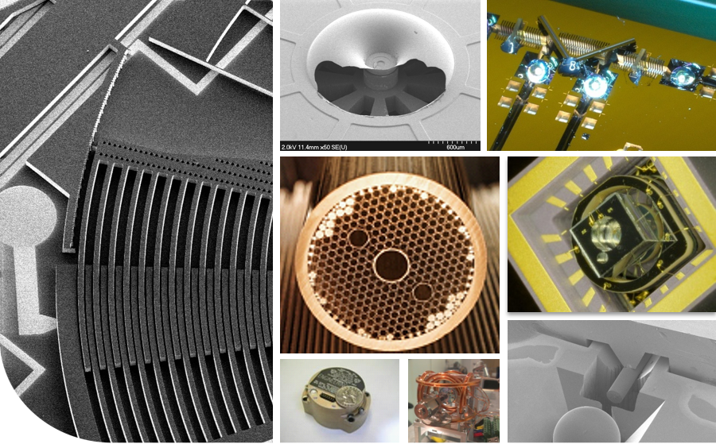
Quantum sensors: atoms, laser light, & quantum states
  Accelerometers (gravimeters)
  Gyroscope (rotation)
  Magnetometer
  Clock (passage of time)
  Time transfer
Position, navigation, and timing
Atoms and laser light can provide high sensitivity

Slide 4
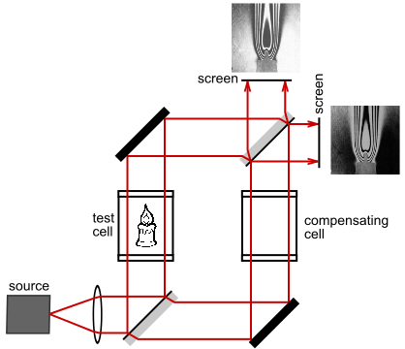
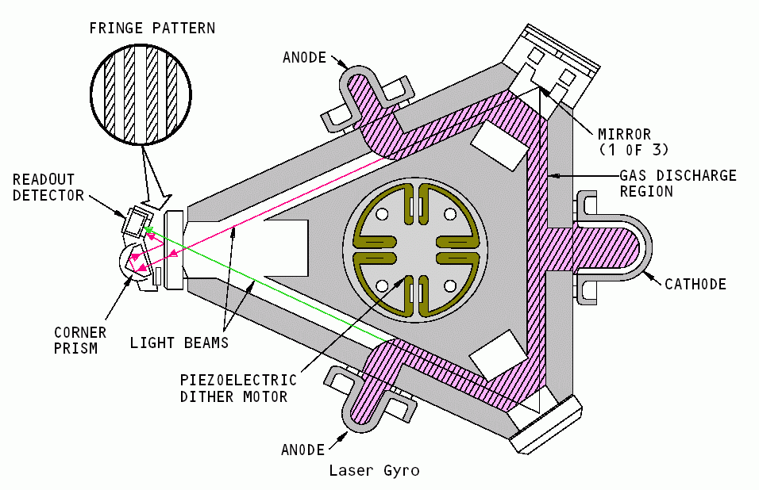
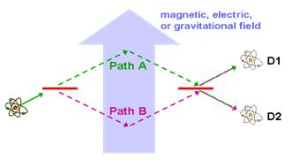
Light Interferometer
Light in two different paths
Area between the paths matters
Rotation sensor: pattern changes if there is rotation
By Stigmatella aurantiaca - Own work, CC BY-SA 3.0, https://commons.wikimedia.org/w/index.php?curid=25125975
acceleration or rotation
To make an atom interferometer, we need to make the atoms do the same
Notes:
Note: this is not a Honeywell-proprietary RLG picture (obtained from web)

Slide 5
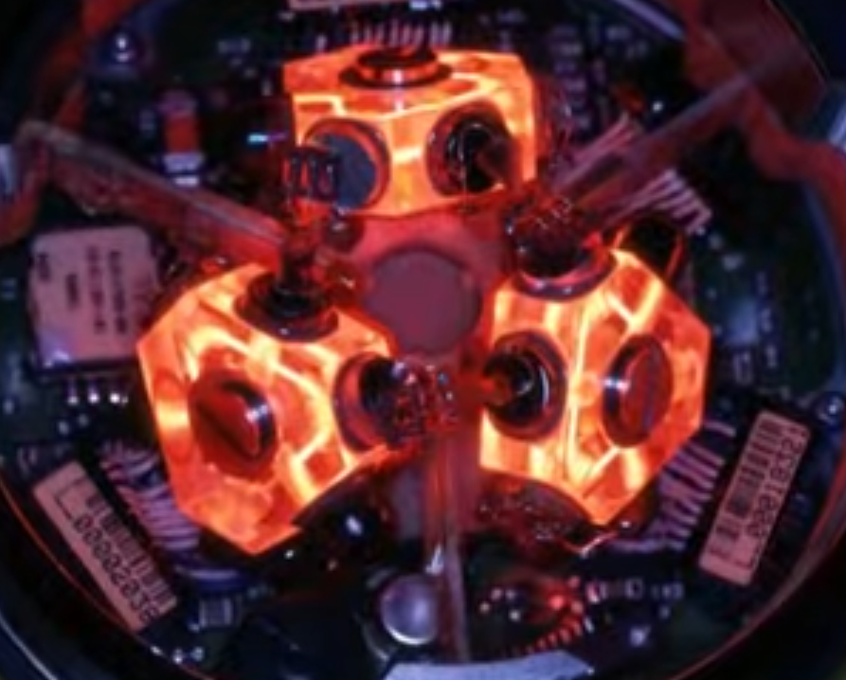

Ring laser gyroscope
$$Ω$$
First level of text, Arial Bold 24pt
  Second level of text, Arial 24pt
    Third level of text, bullet, Arial 20pt
  Two counter-propagating laser paths
  Fringe pattern tracks rotation
  Phase shift proportional to enclosed area
Role of phase in RLG parallels some atomic sensors
Notes:
RLG images found in online search

Slide 6
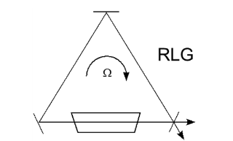
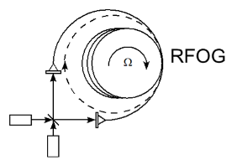
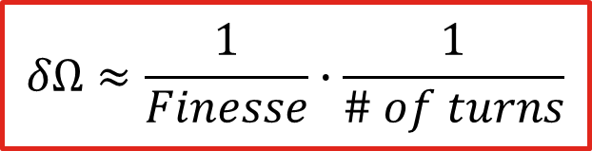
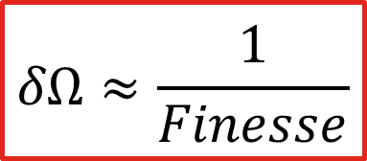
Resonator Fibre Optic Gyroscope
Description – Revolutionary optical technology that combines advantages of ring laser (RLG) and fibre optic gyros (FOG) to provide a new highly scalable type of optical gyroscope that enables new trades between performance/size
Differentiation/Advantage – Low-cost & reduced SWaP architecture. Low loss hollow-core fibre. Chip-scale photonics and light sources.
Product Relevance – Commercial: Designs for extremely good performance in very low SWaP
$$δΩ≈\frac{1}{Finesse}$$
$$δΩ≈\frac{1}{Finesse}∙\frac{1}{\# of turns}$$
RFOG is a game changer for Inertial Navigation

Slide 7
Optical Waveguide Laser Gyroscope (OWL-G)
Description – Brillouin scattering in optical resonators can generate extremely narrow linewidth lasers, which can be applied to optical gyroscopes
Differentiation/Advantage – monolithic chip-scale Brillouin laser gyroscopes can achieve lower SWaP than fiber gyros while achieving comparable levels of sensitivity and extreme robustness
Product Relevance – low SWaP gyros can be mounted on lightweight aircraft and projectiles
Laser chip
CW Laser
CW Laser
Phase Mod
PhaseMod
SOA
SOA
CW Laser
Phase Mod
SOA
Low loss waveguide on chip
Another low SWaP+C approach to GPS challenged navigation
Notes:
scale factor of 152 Hz per degree per second
More on this kind of laser, SBS, later

Slide 8
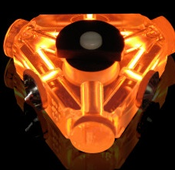
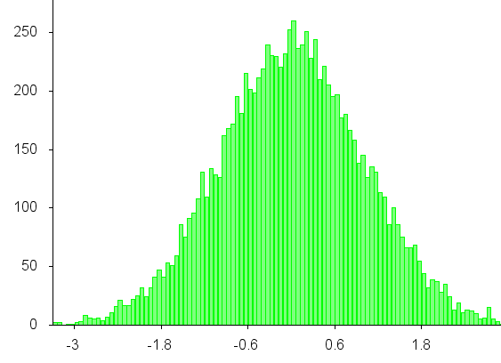
Sensor Variation
Today’s sensors: Variation between parts
  Size, shape
  Composition
  Resonance frequency
  Most companies have “six-sigma” programs to address this variation
  Example: Ring-laser Gyro (RLG) measures rotation; area matters
  Example: Quartz oscillator measures time, but every crystal is different
RLG: any variation in size changes its response to rotation
Histogram of variation in crystal frequency
Atom sensors: Every atom is the same
Notes:
Sources: RLG diagram—used on 100s of sites on the web, origin unclear. Possibly Boeing aircraft manuals
RLG picture: from Wired Magazine, with credit to Honeywell in the caption

Slide 9

Quantum sensors
Atomic, laser and exclusively quantum-based sensors
Laser light
Energy
$$E=ℏω$$
microwave
transition
Superposition is particularly
sensitive: frequency changes (clock)
Atomic states
Atomic states (phase) can be exquisitely sensitive
Notes:
To see how phase can lead to sensitive measurements, let’s look at a gyroscope like Honeywell’s, in production for decades

Slide 10
How Cold are “Cold Atoms”?
3,000,000 K
Sun’s core
30,000 K
Sun’s photosphere
300 K
Life
3 K
Coldest naturally occurring temperature (deep space)
0.03 K
Coldest refrigerator (dilution fridge)
300 µK
3 µK
Laser cooling
30 nK
Specialized laser cooling techniques
evaporative cooling
velocity selection

Slide 11
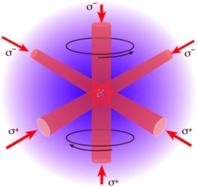
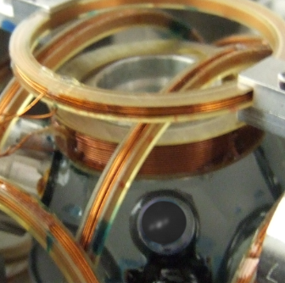
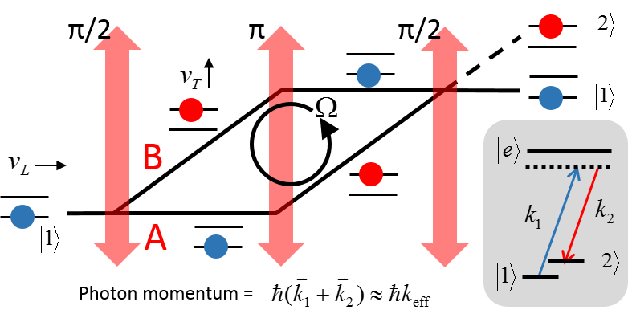
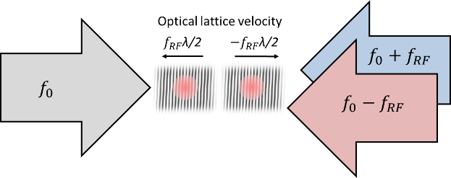
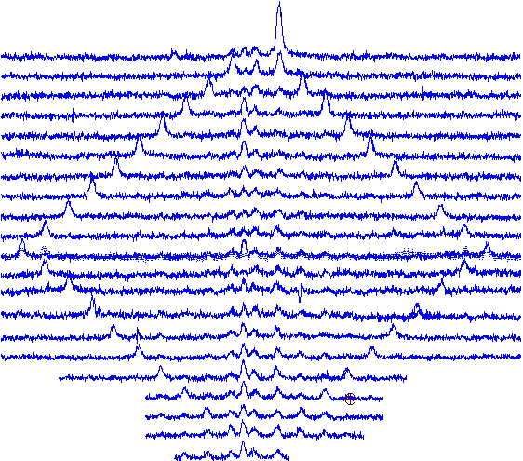

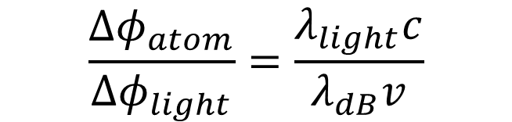
Atomic Interferometers
Ultracold atoms manipulated by lasers & lattices can maximize accelerometer stability
(a)
$$\frac{{Δφ}_{atom}}{{Δφ}_{light}}=\frac{λ_{light}c}{λ_{dB}v}$$
(b)
Atomic Sagnac interferometer exploits wave-like nature of cold atoms
$${≈10}^{10}$$
40 velocity recoils
Low SWaP+C approach to GPS challenged navigation
Notes:
10 uK -> nK

Slide 12

Atomic Interferometers
Overlapping optical lattices
  Accelerate both halves of interferometer in opposite directions
  First demonstrated by Berkeley group (Bragg-Bloch-Bragg)
10
0
-10
-20
-30
0
-2 v_{r}
Bragg
2 v_{r}
Energy (recoils)
Bloch
Bloch
-4 v_{r}
4 v_{r}
Atom Interferometers with Scalable Enclosed Area
Müller Chiow, Herrmann, and Chu, Phys. Rev. Lett. 102, 240403 (2009)
-24 16 -8 0 8 16 24
∆f (recoils)
Overlapping optical lattices

Slide 13
Numerical simulations
Simplified Hamiltonian with 40 momentum states, adiabatic elimination of excited state
Temperature included by Monte Carlo average over Boltzmann distribution of atom velocities
Capability for Gauss-Markov treatment laser RIN and phase noise (not included below)
8 photon Bragg beamsplitter + 28 photon Bloch = 36 photon interferometer
+4 vr
Bragg
π/2
Bragg
π/2
7x Bloch
Accelerate
7x Bloch
Decelerate
Bragg π
7x Bloch
Accelerate
7x Bloch
Decelerate
- 4 vr

Slide 14
Temperature considerations
Numerical simulations vs temperature
8 photon Bragg beamsplitter plus
7 Bloch oscillations each path
= 36 photon maximum separation
Previous Bragg/Bloch data
Contrast > 15%
Bragg beamsplitter efficiency strongly sensitive to temperture
13

Slide 15
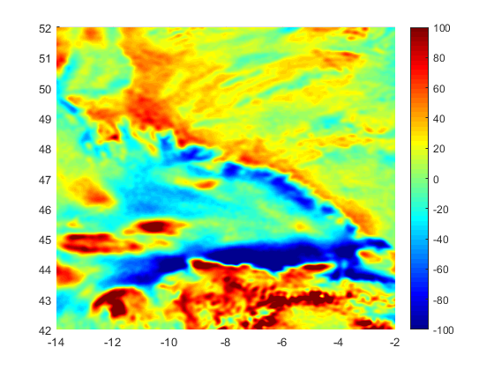
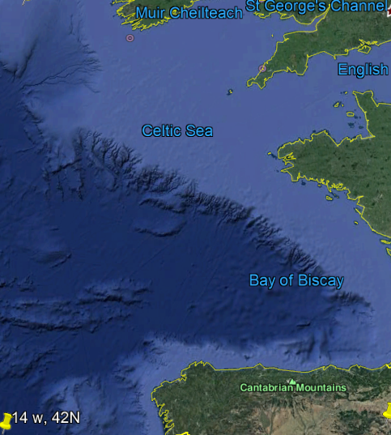
Gravitational Anomaly-Aided Navigation
Gravitational Anomaly Map [uG]
Corresponding Google Earth Map
Ireland
UK
Latitude [deg]
Anomaly [uG]
France
Spain
Longitude [deg]
Gravitational anomalies are caused by density variation in the Earth’s crust
Compare gravity measurement to an a priori gravity map for a position update
Similar to terrain-aided navigation

Slide 16
Approach
Develop simulation for ship use-case
Simulate strapdown IMU aided with high quality vertical accelerometer
Simplification due to sea level altitude
Implemented necessary components for simulation
  Sensor data generation
  Strapdown navigation
  Strapdown navigation error model
  Particle filter with gravitational anomaly measurement and map update
  Filters for comparison (EKF and PF with position measurement and direct anomaly measurement)
Conduct trade study with simulation
Vary characteristics of system components
Vary initial conditions
Block Diagram of Current Simulation
Trajectory
Strapdown Navigation
Navigation Solution
Sensor Data Generation
Sensor Data
Error Model
Nav Solution, Sensor Data, Error Model
Nav and Sensor Error Estimates
Particle Filter
Gravitational Anomaly Map

Slide 17
Simulation Setup and Example result
Trajectory details
    25 m/s (~50 knots)
    110.5 km (68.7 miles), 1hr 13min
    Constant sea level altitude
    Constant velocity and heading, no wave motion
    Trajectory covers region with strong East and North gradients
Filter details
    IMU errors consistent with HG9900
    Initial condition errors under 1km and 0.5 m/s in N and E directions
    Map uncertainty captured in filter tuning, but no map errors in the simulation
    Attitude error impact on gravity measurement not considered, negligible for this choice of trajectory
Stop
Start

Slide 18
Example Result Details
4400
2900
Distance (a.u.)
Distance (a.u.)
2000
1000
0
    Vertical accel: 1 ug bias and -1 ppm scale factor for net 2 ug error
    Vertical accel: VRW 1.25e-3 ft/s/rt(hr) (1/2 Q-Flex VRW)
    Map error and unmodeled anomaly error uncertainty of 0.5ug
Convergence associated with features on the map

Slide 19
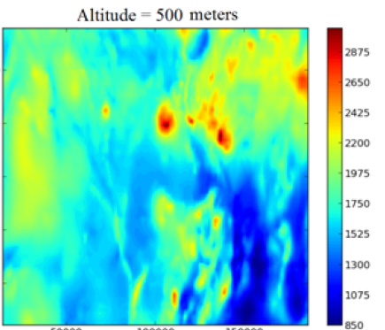
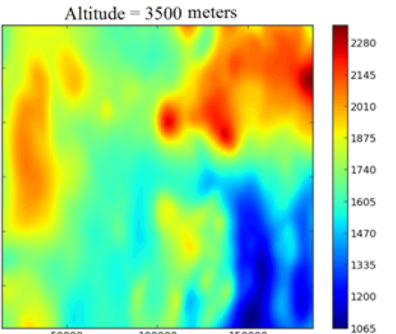
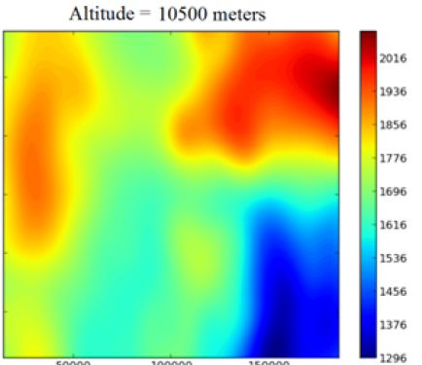
Magnetic Anomaly aided navigation
Magnetic anomaly signal degraded at high altitudes, but applications remain
Proof of concept demonstrated by Air Force Institute of Technology
Miniature atomic magnetometers for scalar measurements are commercially available
Vector and gradient sensing may help to distinguish cabin noise from anomaly signal
Altitude = 500 m
Altitude = 3500 m
Altitude = 10500 m
120 km
200 km
Absolute positioning using the earth’s magnetic anomaly field Canciani and Raquet, J. Inst. Nav. 63, 111 (2016)

Slide 20
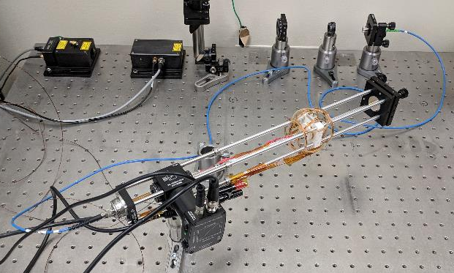
Unshielded Vector atomic magnetometer
Measured magnetic noise higher than desired, but sufficient for magnetic anomaly nav
Noise is nearly identical (except for low frequency and 60 Hz components), likely coming from the heater current or magnetic coils in the setup
Improving the setup could reduce magnetic noise below expected sensitivity, improvements may include
  Improved heater using high frequency AC heating current
  Lower noise current source for nulling coils
  Sensing thermistor resistance using AC excitation current
  Low noise frequency generator for B-field modulation

Slide 21
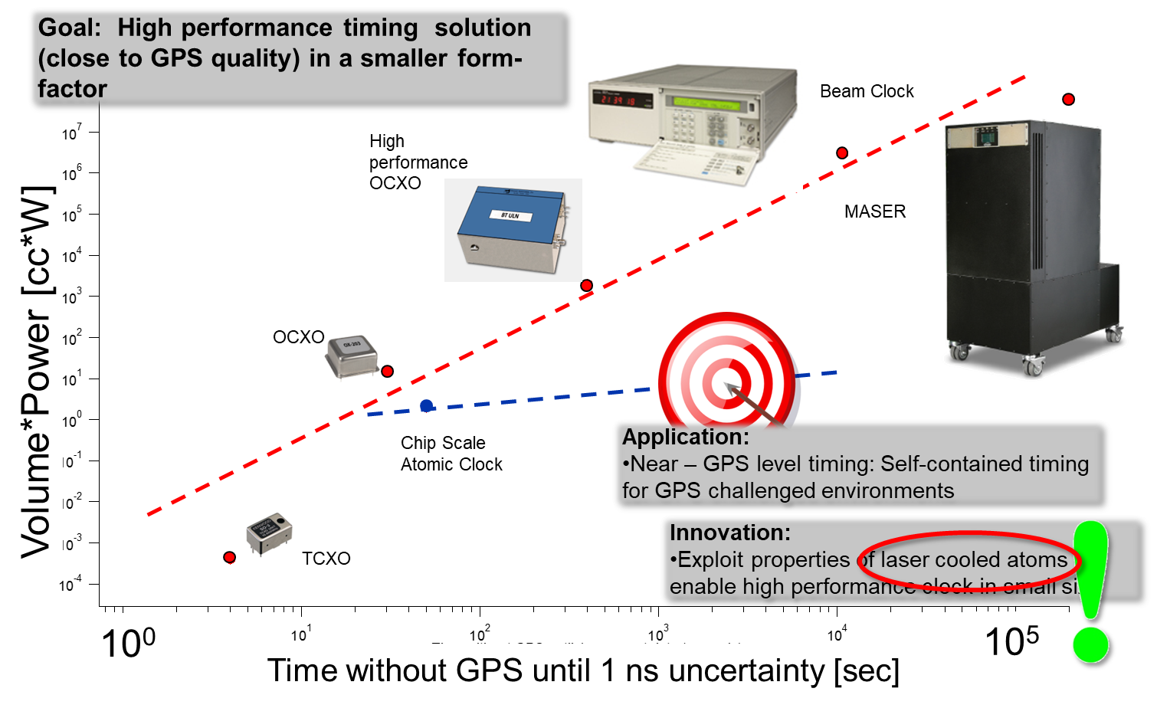
Precision timing: atomic clocks
Portable, optical atomic clock: orders of magnitude increased performance
Notes:
Courtesy ASM group

Slide 22
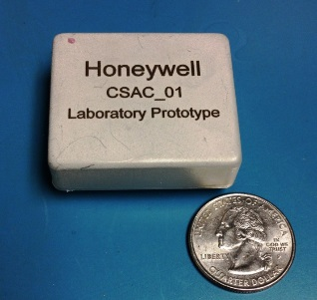
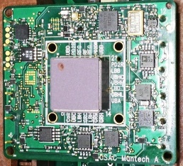
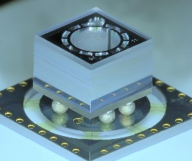
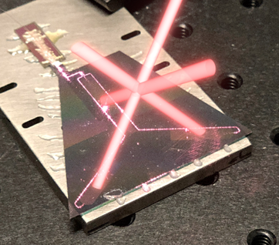
Miniature atomic Clocks
Chip scale atomic clock
DARPA CSAC, Army
Cold atom microwave clock
DARPA IMPACT, ACES
Two-photon rubidium optical clock
AFRL L-ROCK
Strontium optical lattice clock
DARPA A-PhI
Chip-scale atomic clock
Optical grating for Magneto-optical trapping beams (DARPA ACES)
Precision timing for GPS challenged environments

Slide 23
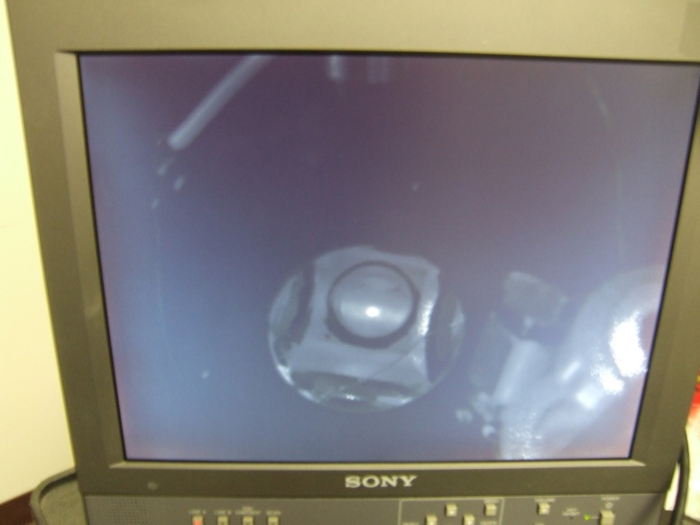
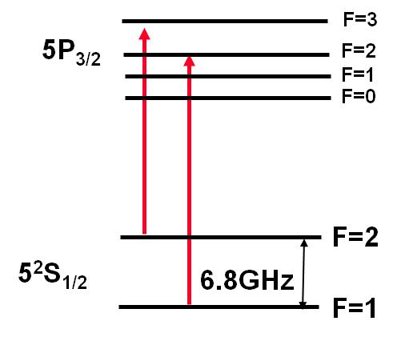
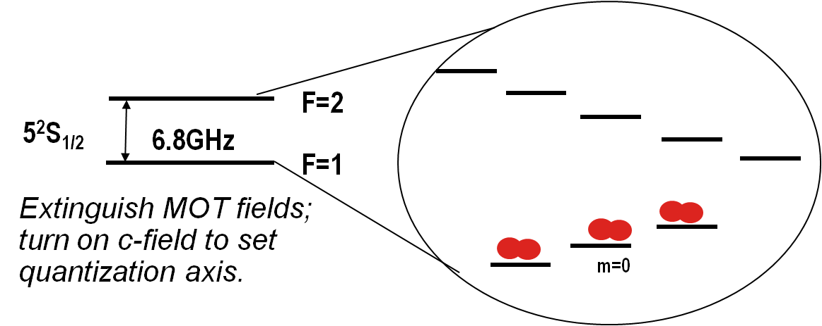
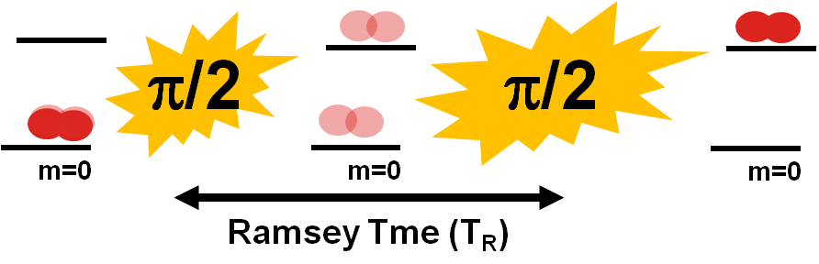
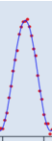
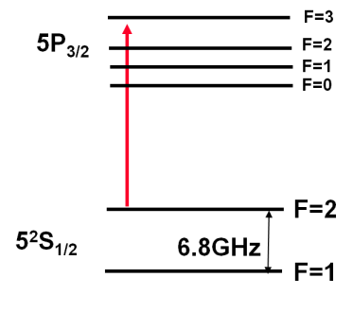
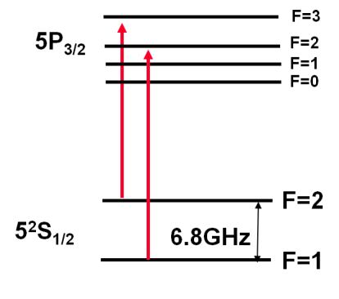
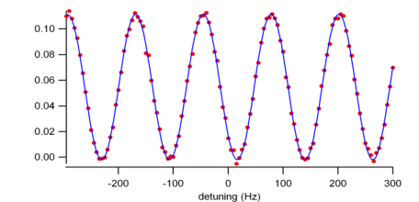
Overview of Atomic Frequency Standard
10 microK (10 millionths of a degree above absolute 0)
1. Cooling and trapping ⁸⁷Rb from vapor
2. State preparation
3. Microwave spectroscopy
5. Feedback to local oscillator
Pre-cooled atoms allow for long Ramsey times
4. Fluorescence readout
+
Notes:
We are 30 million times hotter than these atoms
Sun surface is only 100 times hotter than us; hottest part is only 10,000x hotter

Slide 24
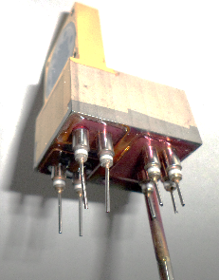
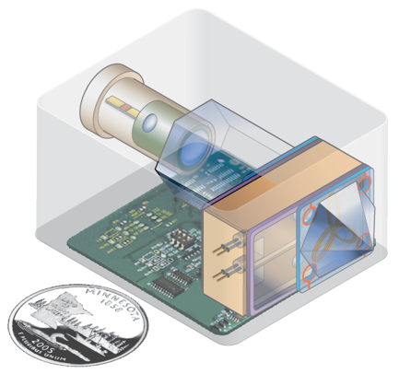
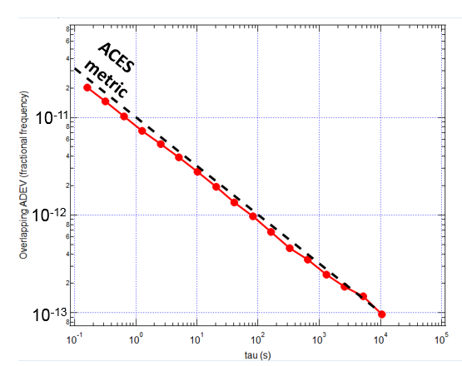
Portable GPS-quality timekeeping (COASTER)
Description – combining proven cold atom clock physics with miniature microwave and optical components to realize ultra-stable atomic timekeeping with game-changing low SWaP
Differentiation/Advantage – laser cooled atoms promise 1000x increase in accuracy as compared to state of the art (CSAC), esp. over large temperature excursions.
Product Relevance – GPS Anti-jam/Anti-spoof, secure comms, direct code acq. in military and commercial markets.
Initial testing to metrics.
Allan deviation [frac frequency]
10⁰
10⁴
Averaging time [s]
Low SWaP, long-term timing accuracy, without GPS

Slide 25
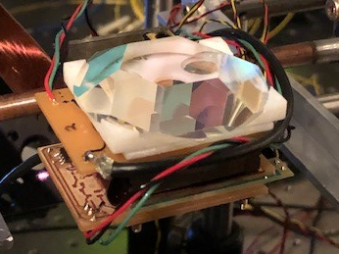
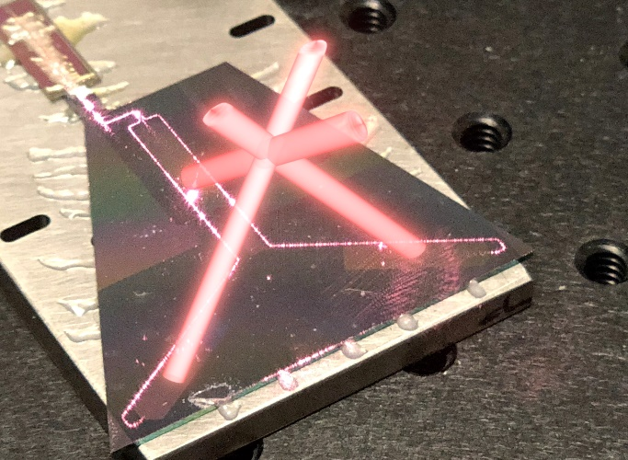
Ultra-cold atoms with waveguide structures
4 cm
Photonic integrated circuits (PICs)
  Patterned waveguides
  Gratings that couple guided modes to free space
Low SWaP physics package
  B-field coils
  UHV chamber
  RF interrogation & detection
PICs promise significantly decreased size and weight

Slide 26
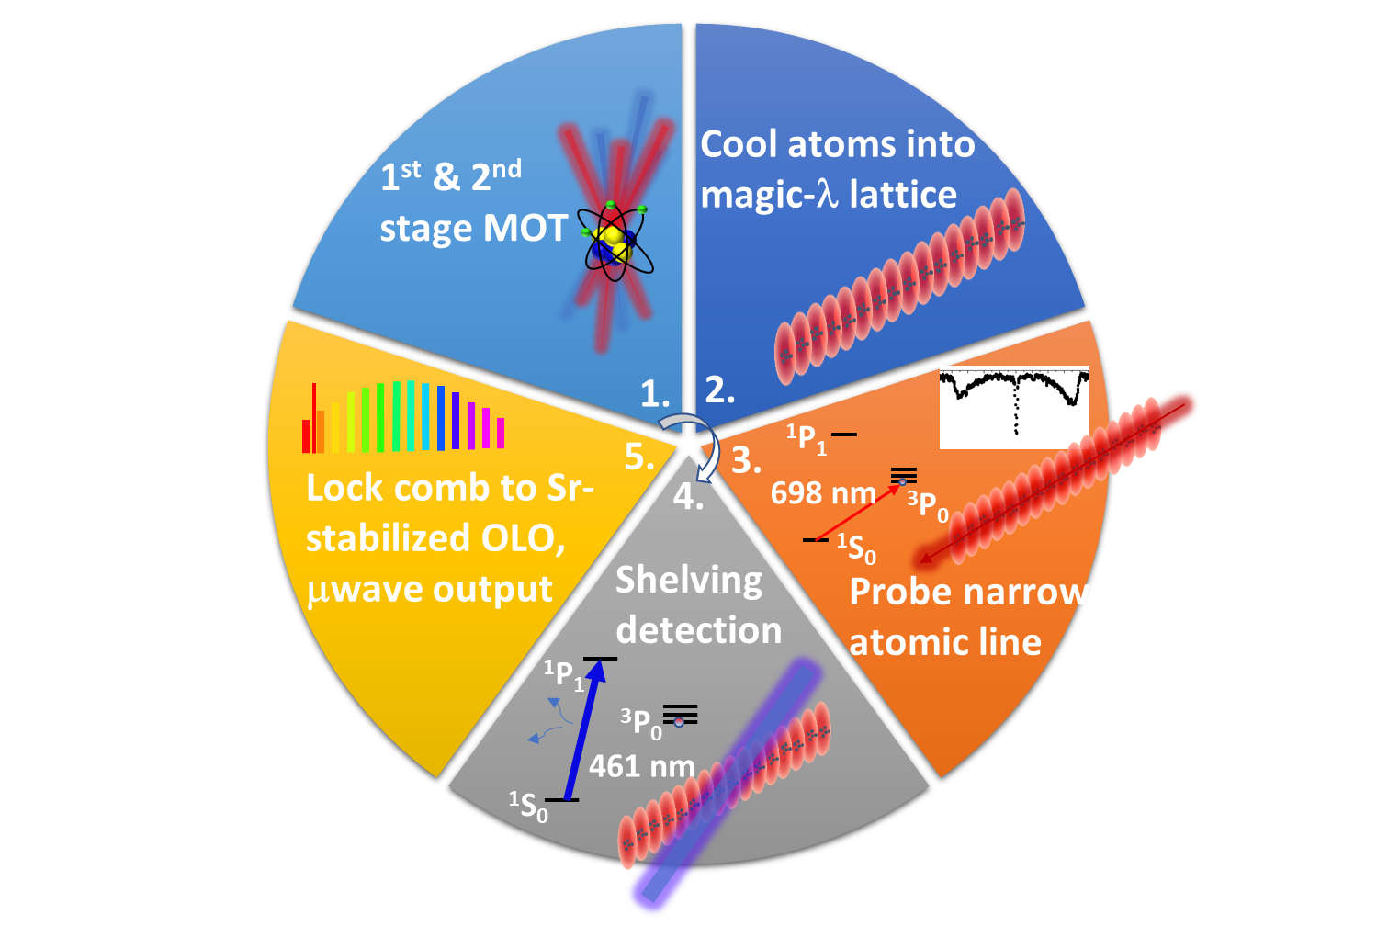

Optical lattice clock
Ultra-stable continuous-wave laser
Ultra-narrow (doubly forbidden) atomic transition
Uses atomically stabilized laser to stabilize a frequency comb for clock output
Takes advantage of inherently stable optical transition:
instability $∝\frac{∆f}{f_{0}}$
Relative frequency instabilities of 3.2 x 10⁻¹⁹ achieved (NIST, Yb)
Notes:
Challenge: achieve potential performance levels promised by lattice clocks in a low-SWaP architecture
Solution: PICs from previous slide and waveguide SBS lasers

Slide 27


Integrated SBS laser
Stimulated Brillouin scattering process
  Waveguide architecture
  Process narrows laser linewidth
$${∆ν}_{fnd}<1 Hz$$
Gundavarapu et al., “Sub-hertz fundamental linewidth photonic integrated Brillouin laser,” Nature Photonics, 13, 60-67 (2019)
SBS lasers could enable next generation of chip-scale optical clocks

Slide 28


Timing with entangled photons
“2002” entangled bi-photon states are produced by pumping a nonlinear crystal.
The condition of equal path time is reflected in a dramatic change in the coincidence statistics at the detectors.
Absolute ranging is not required for synchronizing the two clocks.
Enabling technologies:
  Robust entangled bi-photon source (lasers)
  Miniature optics
Entangled photons could sync. distant satellites to <1ps.

Slide 29





Computing: Honeywell Quantum solutions
Quantum Computing
Trapped-ion Qubit Technology
Current Offerings
Consulting & Design of Experiment
System architecture
Novel gate schemes
Application design
Engineering & Development
Components & subsystems
Cryogenic & vacuum systems
Control systems
Custom QIS test beds
Quantum System Utilization (2019)
Best-in-class computational capability
Chief Commercial Officer: Justin Ging
justin.ging@honeywell.com
Honeywell has significant efforts in quantum-based technology

Slide 30
Quantum sensors: enabling technologies
Low loss optical waveguides, extending into blue, UV
RF/microwave engineering
Lasers
    Integrated in active structures
    Stable over T in power and frequency
    New colours (e.g. UV)
Single and entangled photon sources
Optical fibers in blue/UV
Atomic sources
    Low generating power and small size
    Stable over T
UHV technology
Miniature optics
    Photonic chip interconnects
    Free-space and fibre coupling
Active Honeywell development in these areas

Slide 31







Survey of quantum technologies
Inertial
Non-GPS navigation
Timing & synchronization
Future quantum technologies
¹P₁
698 nm
³P₀
¹S₀
Komar, et al., PRL 117 060506 (2016)
Hosten, et al., Nature
529 505 (2016)

